Slide 1

ecommendation System
Turki Khalid Alqahtani 2236938
Rayan Yosof Fadhil 2135390
Raed Ahmed Alsafry 2236088
Omar Waleed Alsiary 2236983

Slide 2
Components
1
2
3
4
5
Introduction
Dataset
Collaborative Filtering (User-Based)
Popular-Based Filtering (Extra)
Conclusion

Slide 3
1
Introduction

Slide 4
Item Recommendation for Users
Objective: Create a system that uses recommendation algorithms to make item recommendations based on user preferences.
Model Used:
Collaborative Filtering: Using similarity between users.
Other Models:
Content-Based Filtering: Examines item characteristics that align with user preferences.
Hybrid Models: Combines both approaches to overcome limitations.

Slide 5
Key Features and Outcomes
Key Features:
Scalable to effectively manage big datasets.
Capable of learning from user interactions to improve recommendations over time.
Outcome:
The system adapts dynamically as more data is collected, refining and improving recommendations over time.
Increase engagement and satisfaction through relevant product suggestions.

Slide 6
2
Dataset

Slide 7
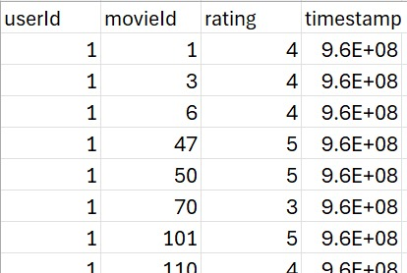
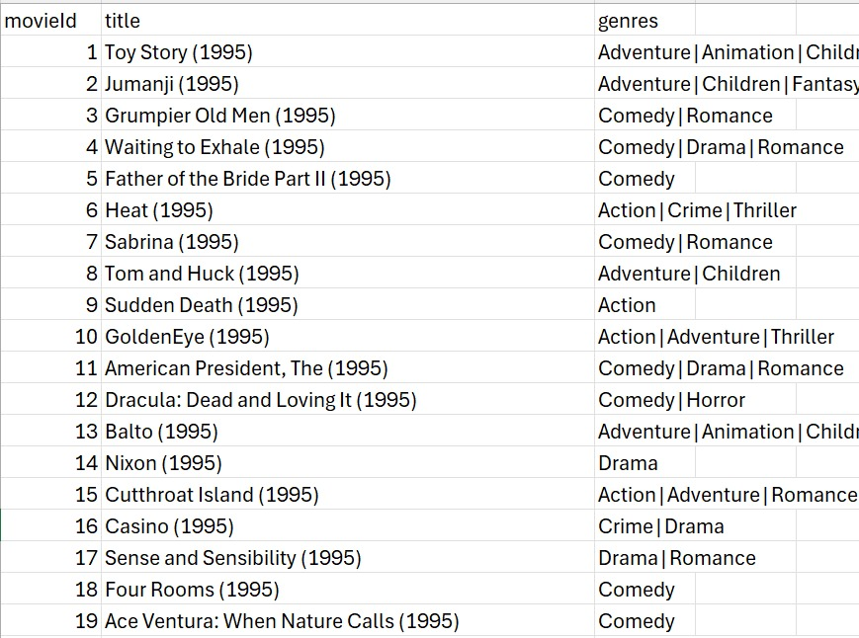
Dataset
The dataset are two files:
ratings_movies.csv
movies.csv

Slide 8
Dataset source
The dataset was sourced from https://grouplens.org/datasets/movielens/

Slide 9
Missing and incomplete data
Missing values: Movie title is missing in the file ratings_movies.csv.
Data Completeness: No incomplete data, all users in the dataset have rated the items.
Imputation strategy: we merged the two files to a single dataset containing (Movie Title and Movie ID)

Slide 10
Descriptive statistics
Number of unique users: 610
Number of unique movies: 9724
Number of unique ratings: 10
Mean of ratings: 3.501
Median of ratings: 3.5
Variance of ratings: 1.087
Standard Deviation of ratings: 1.042529
Highest of rating: 5.0
Lowest of rating: 0.5

Slide 11
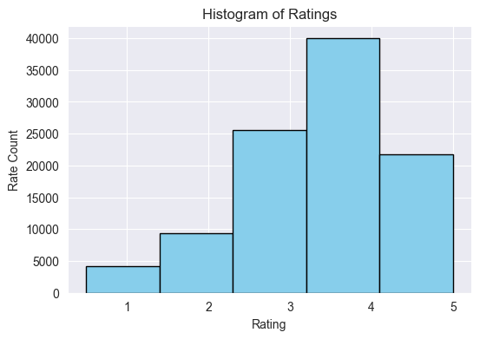
Ratings Histogram

Slide 12
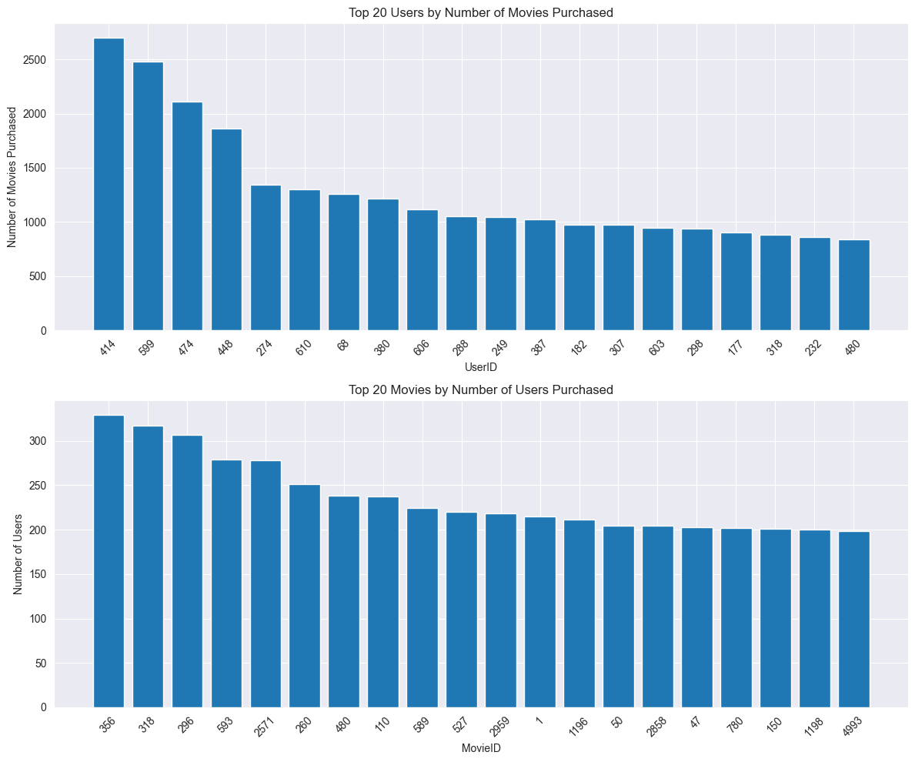
Distribution of interactions

Slide 13
Features correlations
To make a correlation matrix that will explore relationships between features, we can only use numeric features from the dataset, listed below are the only features applicable to measuring correlation between each other:
Average Rating.
Number of Rating (Popularity).
Other columns had unapplicable data to calculate a meaningful correlation.

Slide 14
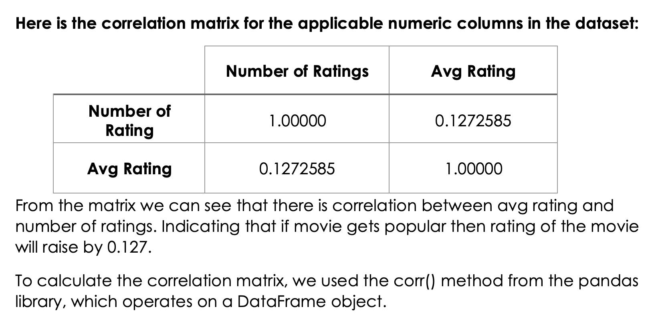
Correlation matrix

Slide 15
Data cleaning & preprocessing

Slide 16
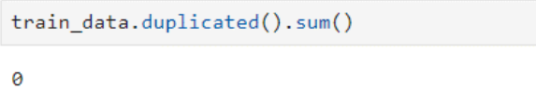
Handling duplicates
Tracking duplicates
To check if there are any duplicates, we will use the following method:
Since the output is 0, there are no duplicates in our dataset

Slide 17
3
Collaborative Filtering (User-Based)

Slide 18
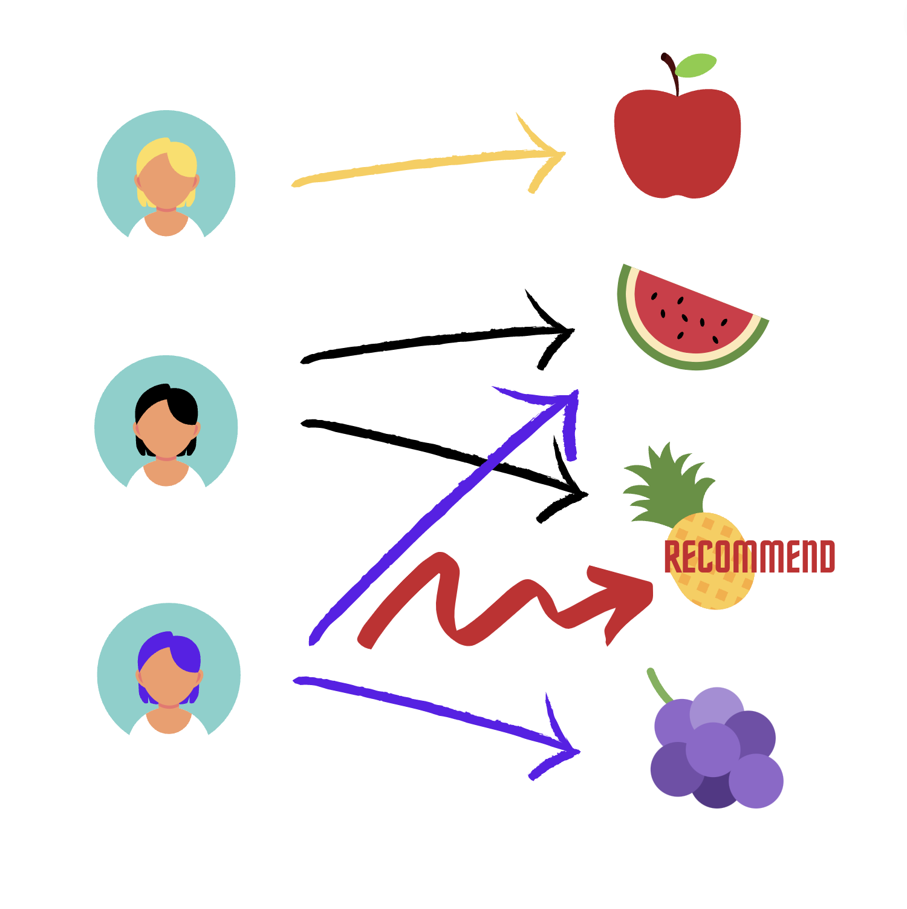
What is Collaborative Filtering ?
User-based collaborative filtering makes recommendation based on user-item interactions in the past. The assumption behind the algorithm is that similar users like similar movies.

Slide 19
User-based collaborative filtering algorithm usually has the following steps:
1- Adding Movies Title
2- Exploratory Data Analysis (EDA)
3- Create User-Movie Matrix
4- Data Normalization
5- Identify Similar Users (Pearson Correlation)
6- Narrow Down Item Pool
7- Recommend Items

Slide 20
4
Popular-Based Filtering (Extra)

Slide 21
Popularity-Based Filtering
The basic idea behind popularity-based filtering is that the movies that are generally popular among all users are recommended to new or existing users, assuming that they are probably going to like these movies.

Slide 22
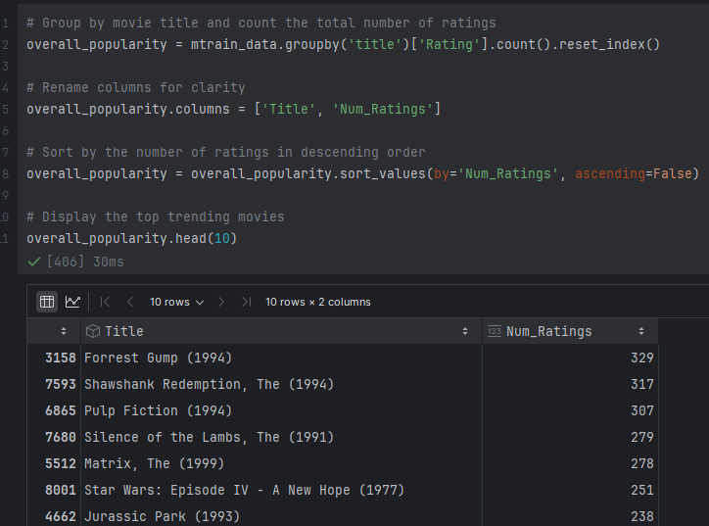
Overall Popularity
Ranking of the movies depends only on the total number of ratings a movie has received across the entire dataset. It doesn’t matter whether the ratings are high or low.

Slide 23
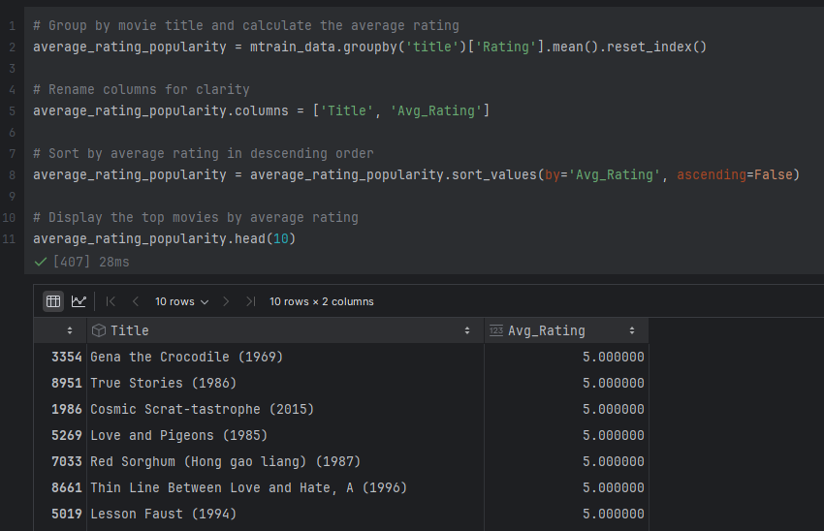
Average Rating Popularity
Rank movies based on their average rating instead of the count. This highlights the highest-rated movies.

Slide 24
5
Conclusion

Slide 25
Challenges And Difficulties
In the early start we used an amazon dataset that stores customers and the products they bought from the website. The dataset was inefficient and incomplete, it was missing product names, and the number of rows was too large which didn’t allow us to create a User-Item matrix due to our RAM not being able to handle its big size. We just couldn’t complete the project with that dataset so changed it to the current one.

